Slide 1
Dublin Business School
Nov 2019

Slide 2
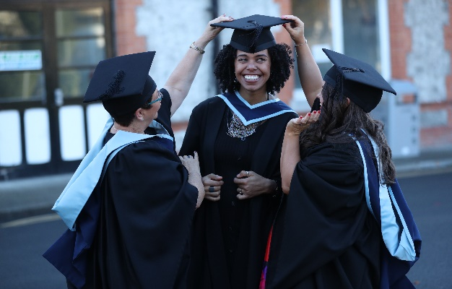
History of Dublin Business School
Established in 1975
Acquired LSB College in 1999
Acquired by Kaplan Inc. in 2003
Acquired EBS in 2006
Acquired Portobello College in 2007

Slide 3
About Dublin Business School
Largest independent institution in Ireland
Pathway programs in Business English, Undergraduate, graduate, executive and professional programmes in Business, IT, Arts, Psychology, Film and Law
Part of Kaplan, Inc., the education division of Graham Holdings Company
Kaplan Inc. the world leader in education, serves more than one million students per year

Slide 4
Why Dublin Business School
9,500+ students
100+ accredited programmes
44 years in operation
80 nationalities
75+ university partnerships Worldwide

Slide 5
Recognition and Accreditation
Over 100 accredited courses recognised internationally

Slide 6
Partners and Agents Worldwide

Slide 7
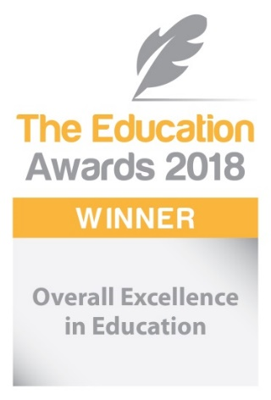
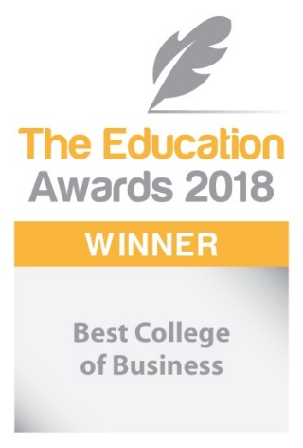
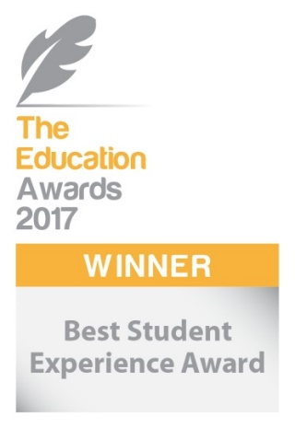
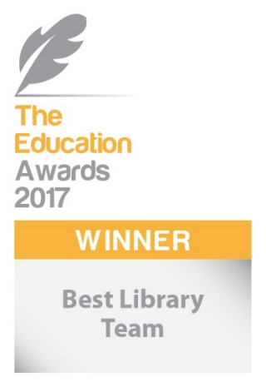
Awards

Slide 8
Why Dublin?
Ireland | Dublin
Friendly people | Cosmopolitan
Safe, peaceful and green | Safe and friendly
Simple visa process | Friendly, youthful international atmosphere
Graduate work opportunities | Part - time work opportunities
English speaking | All major embassies within easy reach of the college
Established educational tradition | Easy access to European cities
Euro currency | Always in ‘Top 10’ most popular study destination's

Slide 9
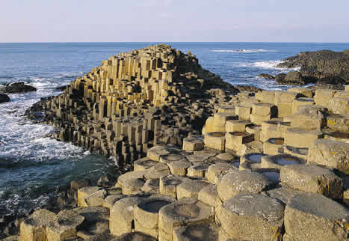
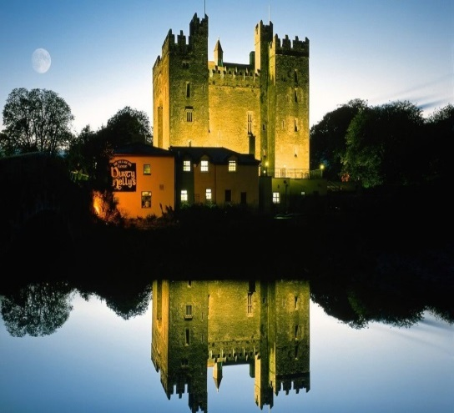
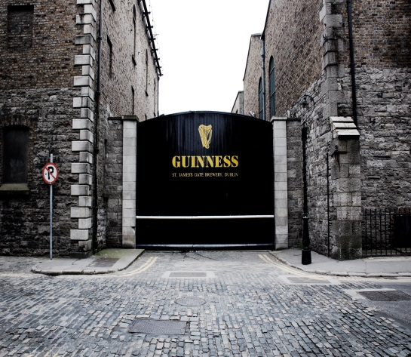
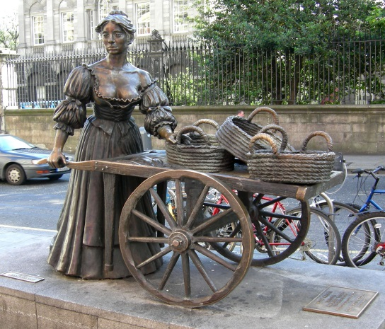
Famous Places

Slide 10
Why DBS?
An ability to get a government-accredited and internationally recognised qualification from an English speaking country
A career-focused education
Quality of teaching
Student-centred emphasis on teaching
Wide range of PG & UG courses in Business, IT, Law & Arts
Friendly accessible staff and students
Connected with industry
Value for money with affordable fees
City centre location
Many accommodation options
Decades of experience assisting international learners with language and academic support – 44 years old
Accreditation by professional bodies

Slide 11
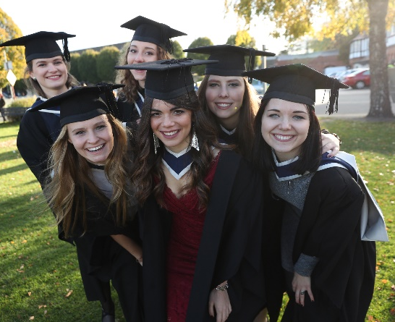
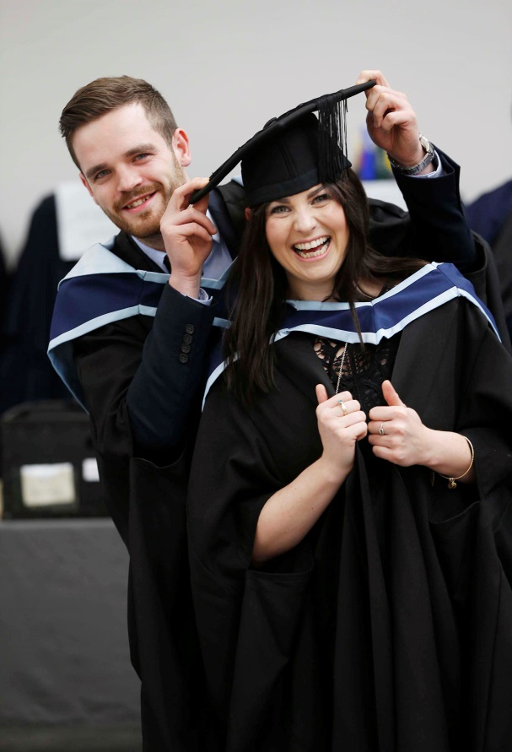
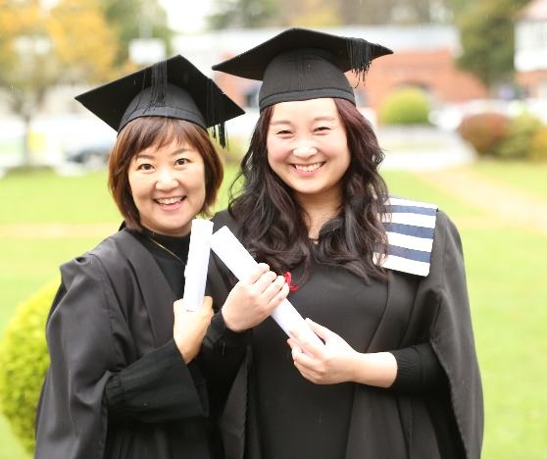
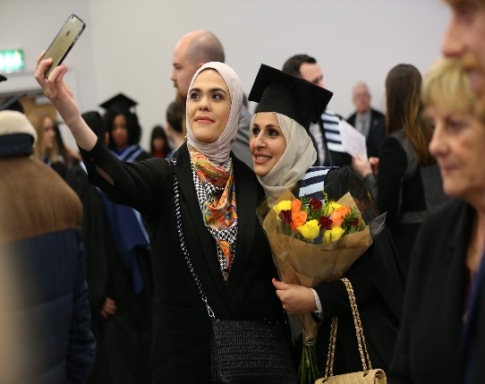
Graduation

Slide 12
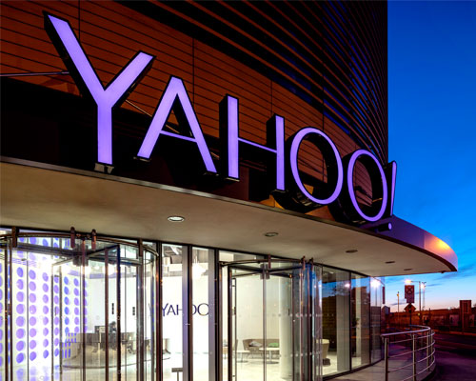
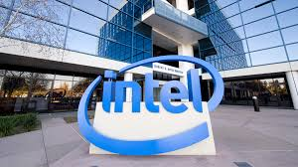
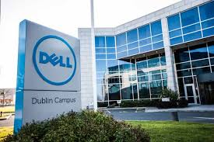
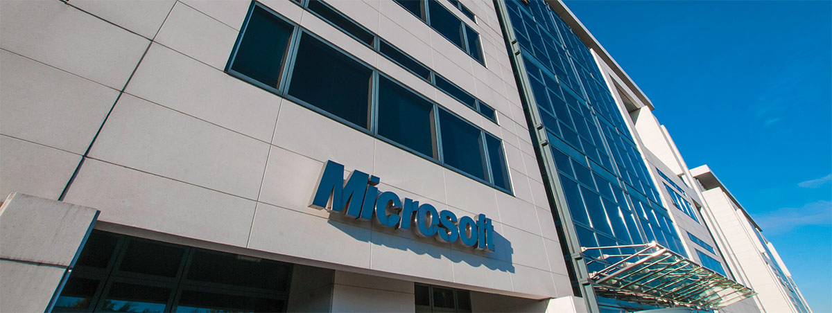
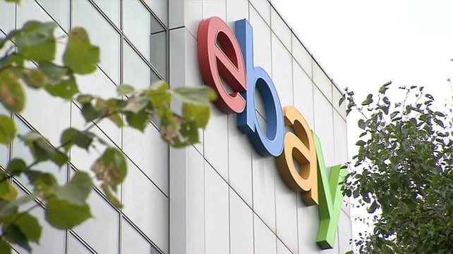
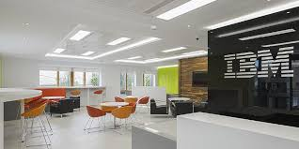
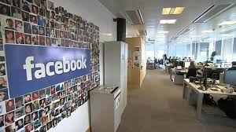
Europe’s Tech Hub

Slide 13
UG Programmes at DBS
HRM
Accounting & Finance
Digital Media
Computing
Law
Film
Event Management
Psychology
Social Science
Business
Marketing
Sound Engineering
Social Care

Slide 14
Postgraduate Programmes at DBS
MBA with Streams (General, HRM, Marketing, Project Management, Finance, Information Systems & Cloud Computing)
MSc in International Accounting & Finance
MSc in Digital Marketing
MSc Information Systems with Computing
MSc Fin Tech (Financial Technology)
MSc Data Analytics
MSc Business Analytics
MSc in Applied Psychology
MA in Addiction Studies
MSc Management Practice
MSc Marketing
Post Grad Higher Diploma in Business

Slide 15
Entry Requirements at DBS
COURSE QUALIFICATION REQUIRED for Level 6 Certificate in Business & Language & Higher Certificates with a minimum of PASS in one of the below with IELTS 4.5:
Devlet Lise Diplomasi (State High School Diploma)
Devlet Meslek Lise Diplomasi (State Vocational or Trade High School Diploma)
Lise Bitirme Diplomasi (Private High School Finishing Diploma)
COURSE QUALIFICATION REQUIRED for Level 7 Ordinary Bachelors Degree with minimum of 50% in one of the below with IELTS 5.5
Devlet Lise Diplomasi (State High School Diploma)
Devlet Meslek Lise Diplomasi (State Vocational or Trade High School Diploma)
Lise Bitirme Diplomasi (Private High School Finishing Diploma)

Slide 16
Entry Requirements at DBS
COURSE QUALIFICATION REQUIRED for Level 8 Honours Bachelors Degree with a minimum of 65% in one of the below with IELTS 6.0
Devlet Teknik Lise Diplomasi (State Technical 4-Year High School Diploma)
Devlet Lise Diplomasi (State High School Diploma)
Devlet Meslek Lise Diplomasi (State Vocational or Trade High School Diploma)
Lise Bitirme Diplomasi (Private High School Finishing Diploma)
COURSE QUALIFICATION REQUIRED for Level 9 Masters Degree with IELTS 6.0
Bachelor Degree in relevant or non-relevant discipline as appropriate with A minimum of second class or CGPA of 2.00/PASS, 3.00 – 3.49/ HONOURS, 3.50 – 4.00/ FIRST)

Slide 17
Tuition Fees at DBS
1 Year Certificate in Business & Language at €6200
3 Months Pre Masters/ Pre Under Graduate at €1990
3 year Undergraduate programs at €9850 with a scholarship option of €500 in Year 1 & 2 and €1900 in year 3
1 year Post Graduate program at €12000 with a scholarship option of €1000

Slide 18
Intakes at DBS
January 2020
April 2020
September 2020

Slide 19
Career Services
Extra Curricular Activities
Employability and Career Development
Learning and Disability Support
Post Study Stay back Options
Ordinary bachelors – 6 Months
Honours Bachelors – 1 year
Masters – 2 years
Careers and Student Experience:
Focus Areas
Counselling Options
International Student Support: accommodation, financial, visa advice
Student Welfare
Empowering Students

Slide 20
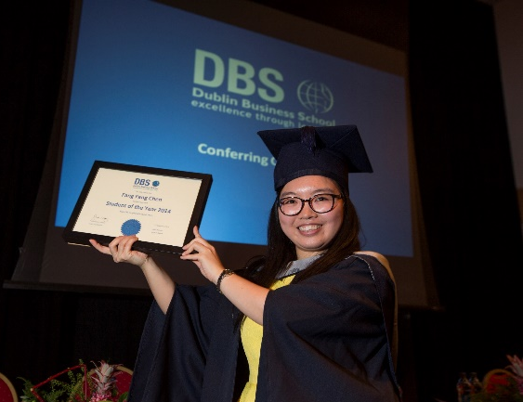
What our students say
“I first considered DBS when I heard about the great reputation they had in the business industry, and the admissions team were very good. After my three years of study I know that I made the right decision. I have made great friends from all corners of the world, and learned about different cultures. I was hugely inspired by the talented lecturers, and not only gained professional knowledge, but I also learnt how to work as a team and gained a lot of confidence. I feel like I am really well equipped to begin my career now!”
Fangfang Chen
Student of the Year 2014
BA (Hons) Accounting and Finance

Slide 21
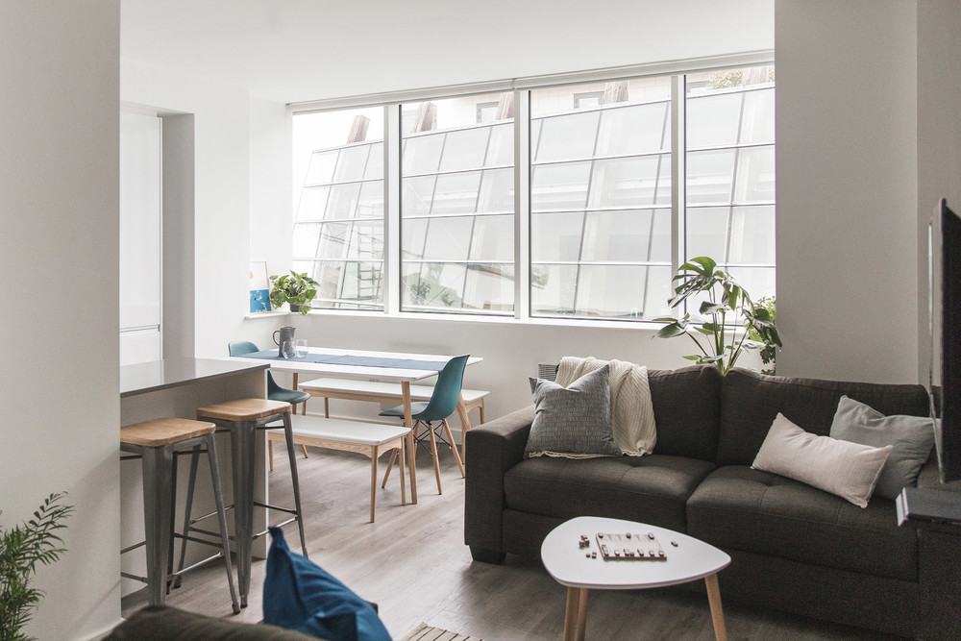
Accommodation
Residences
Host Families
Rent apartments www.daft.ie
www.dbs-students.com/accommodation

Slide 22
Student Services

Slide 23
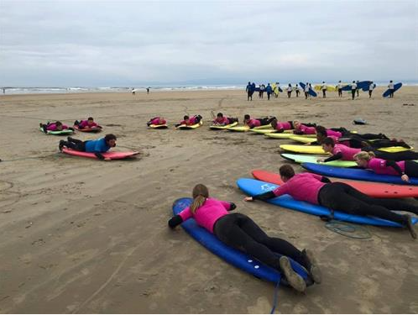
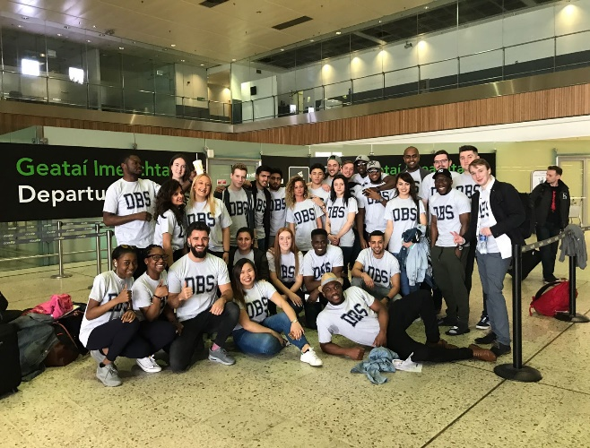
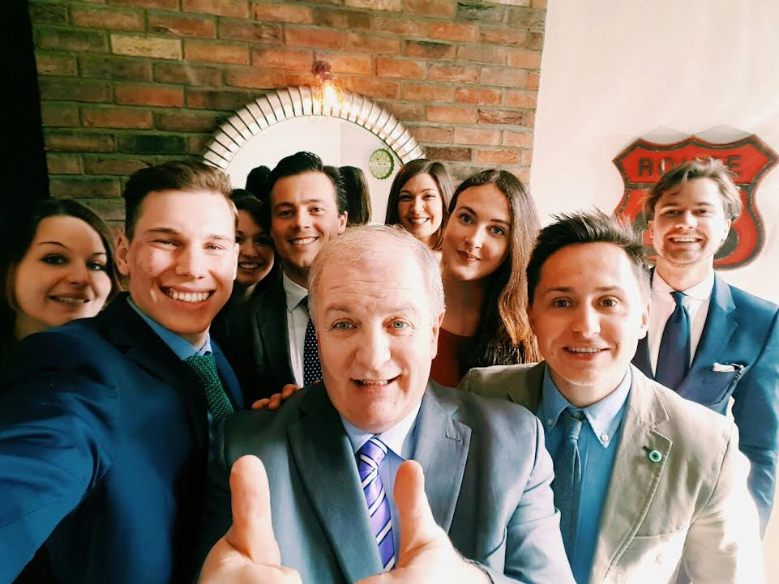
Clubs and Societies

Slide 24
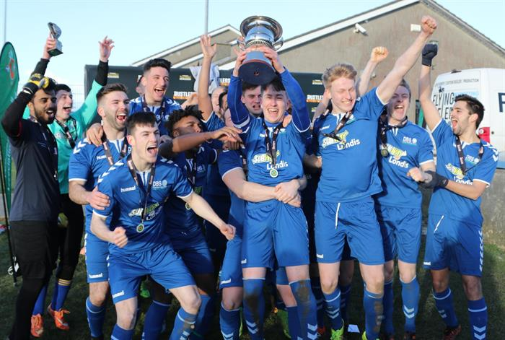
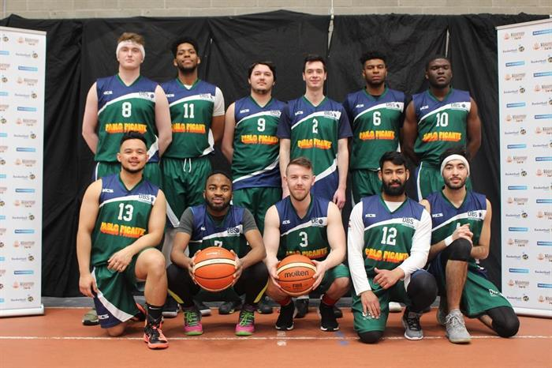
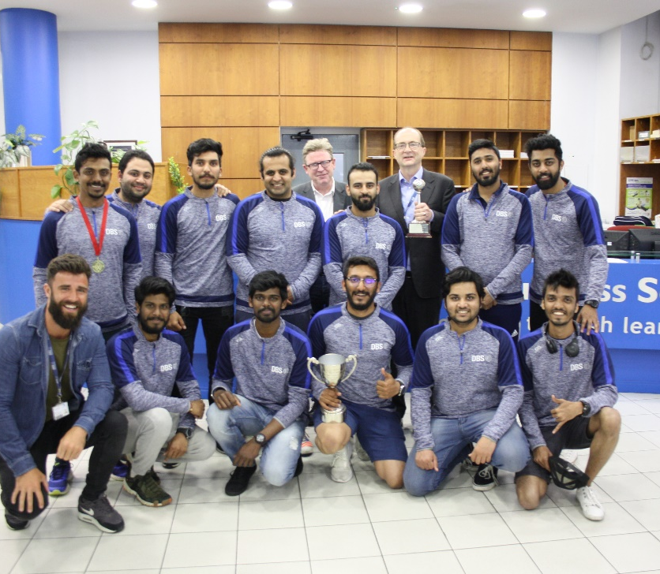
Sports
Soccer: Bob Eustace Cup Champions 2017, 2018 and 2019
Basketball: Champions 2018
Cricket: Intervarsity Champions 2019

Slide 25
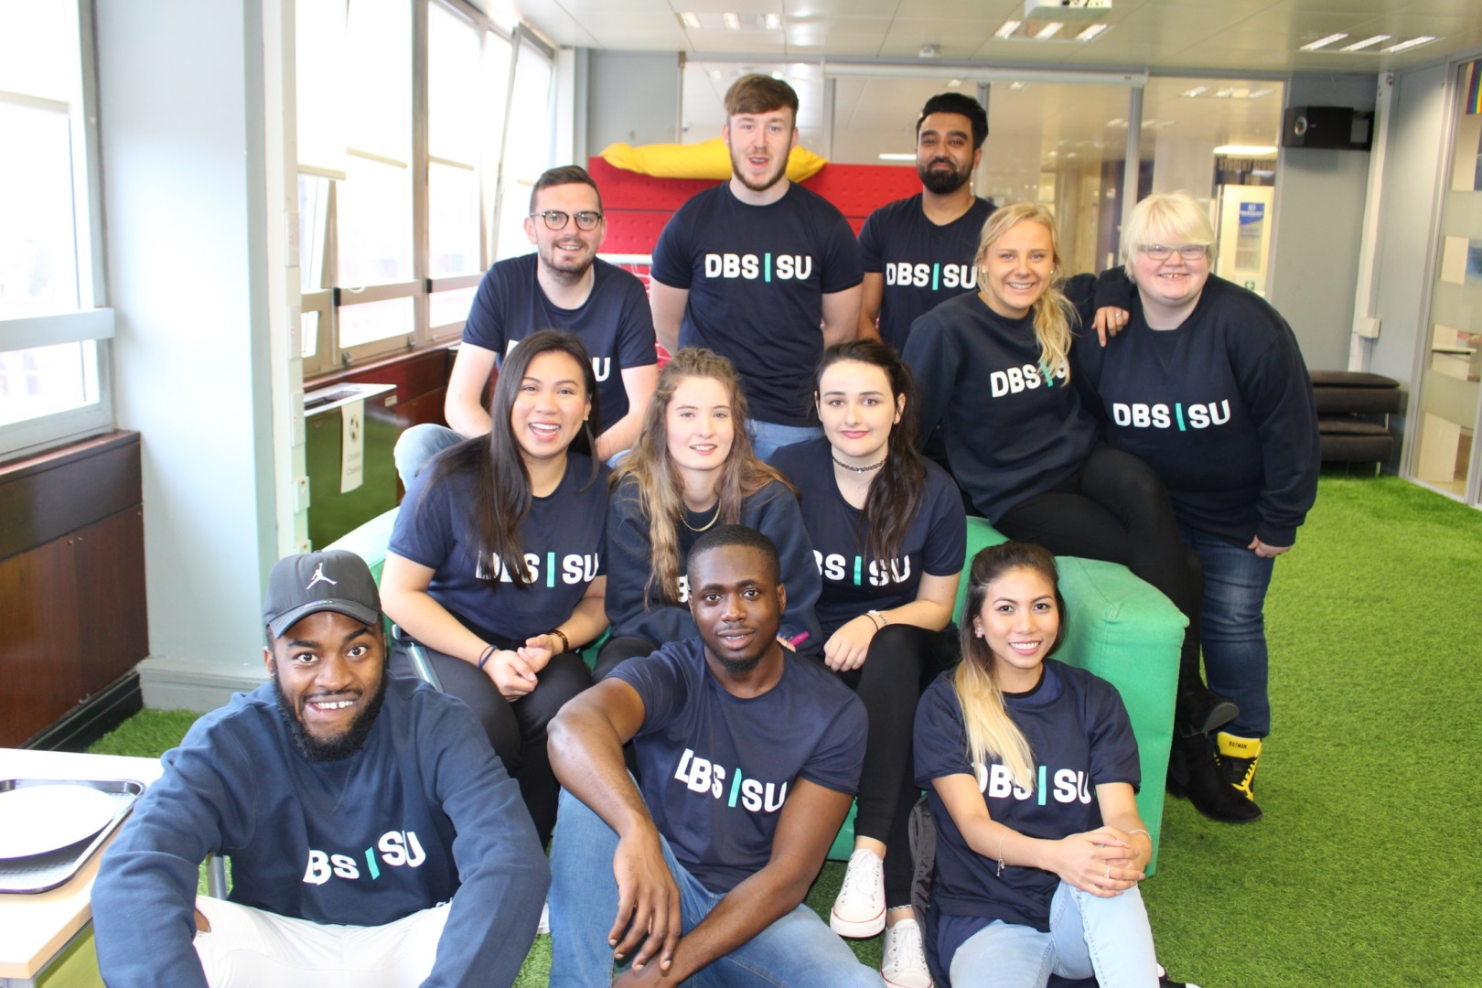
Student Union Officers

Slide 26
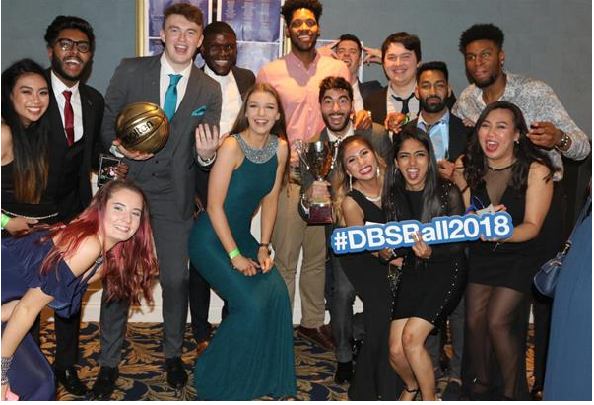
Annual Formal Ball

Slide 27
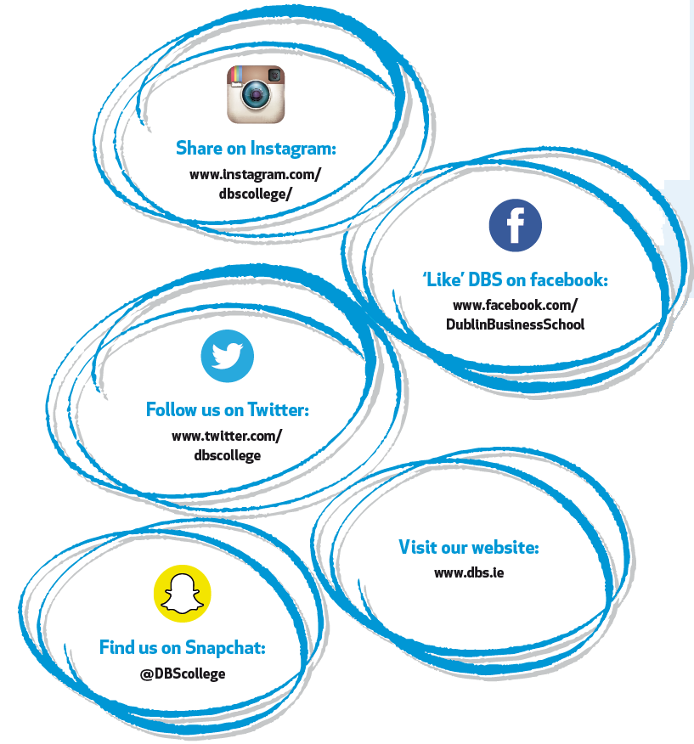
Contact Us
International@dbs.ie Prasad.kholli@dbs.ie
+353 1 417 7500
+91 9553169767
www.dbs.ie

